Slide 1
Confidence-Based Model Fusion (CBMF) for Robust Adversarial Detection in Multi-Controller SDNs
MEMBERS:
SHINMAYA K B 9517202306091
SHREE HARINI K 9517202306092
VARSHA G A 9517202306111
MENTOR:
Mr.M.V.Balaganesh BTech, MTech
Assistant Professor-IT Department

Slide 2
AIM
Detect and isolate compromised SDN controllers under adversarial (poisoning) attacks.
Improve detection accuracy using confidence-weighted model fusion.
Enhance TAPD framework by integrating controller reliability scores.
Maintain robustness and precision in multi-controller SDN (MSDN) environments.

Slide 3
OBJECTIVES
Introduce confidence scoring for controller reliability evaluation.
Prevent false votes from compromised controllers.
Use weighted voting to strengthen TAPD’s decision-making.
Validate system performance using UNR-IDD dataset under varying attack ratios.

Slide 4
NETWORKING CONCEPT
Based on SDN architecture with multiple controllers providing centralized monitoring and distributed control for scalability.
Each controller uses an ML-based NIDS to analyze network traffic and detect anomalies locally.
Controllers share trained models and evaluation metrics with peers for cross-validation and trust assessment.
The Command Center aggregates confidence-weighted votes to identify and isolate compromised controllers.

Slide 5
SOFTWARE ENGINEERING CONCEPT
Modular Design – The system is organized into independent modules for simplified development, testing, and scalability.
Layered Architecture – The project follows a multi-layer structure separating data processing, logic, and control functionalities.
Algorithmic Design and Analysis – Each module is implemented using precise algorithms supported by mathematical models.
Testing and Validation – The system is verified through module-wise testing and performance evaluation metrics.

Slide 6
DATA MINING CONCEPT
Uses Random Forest classifiers for anomaly detection.
Analyzes traffic patterns and error metrics across controllers.
Derives confidence weights from model self-errors.
Combines predictions through confidence-based aggregation.
Applies outlier detection techniques to isolate abnormal behaviors and maintain trust in the SDN control plane.

Slide 7
LITERATURE SURVEY
Existing TAPD Framework
Advantages:
Detects adversarial poisoning through cross-evaluation.
Leverages multi-controller collaboration.
Limitations:
Treats all controller votes equally, ignoring trust levels.
Can misclassify due to compromised voting sources.
literature survey_final.pdf

Slide 8
LITERATURE SURVEY
Confidence-Based Fusion Approaches
Advantages:
Improves ensemble reliability through confidence weighting.
Reduces noise from unreliable model contributors.
Limitations:
Requires accurate self-error measurement.
Additional computation during aggregation.

Slide 9
LITERATURE SURVEY
Proposed CBMF System
Advantages:
Assigns confidence weights to each controller’s evaluation.
Stronger resistance to poisoning attacks.
Improves detection accuracy, precision, and recall.
Limitations:
Needs well-calibrated confidence thresholds.
Performance depends on consistent error estimation.

Slide 10
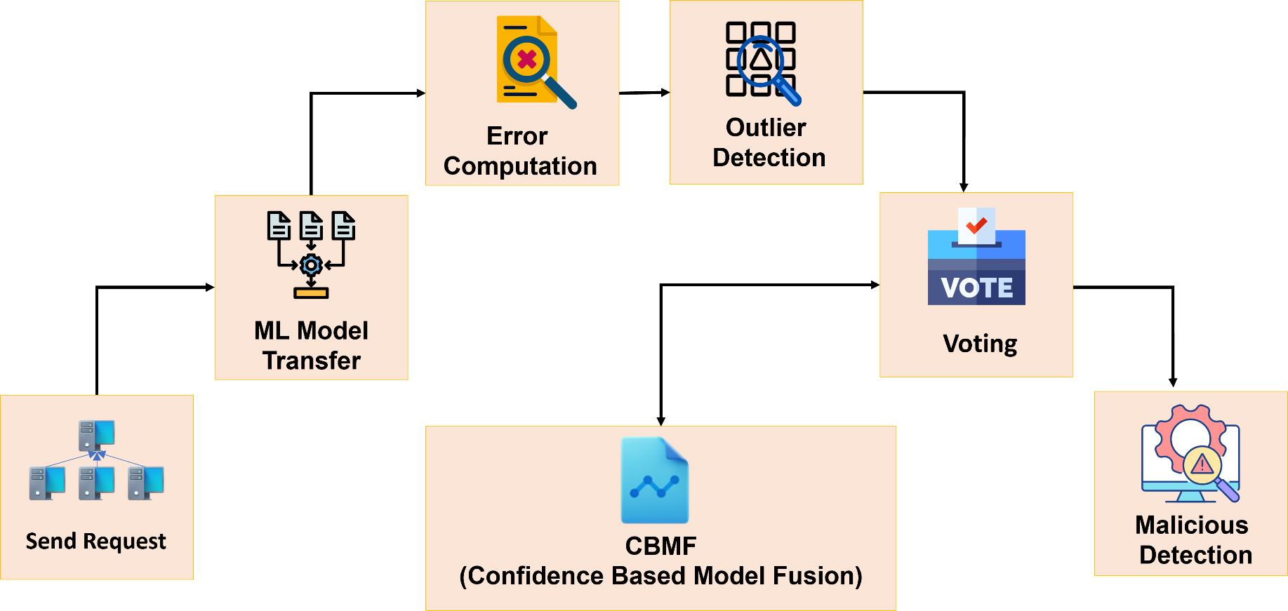
OVERALL WORKFLOW

Slide 11
MODULES
Model Training
Model Transfer
Cross-Evaluation
Weighted Voting
Final Aggregation
CONFIDENCE SCORING (Novelty)

Slide 12
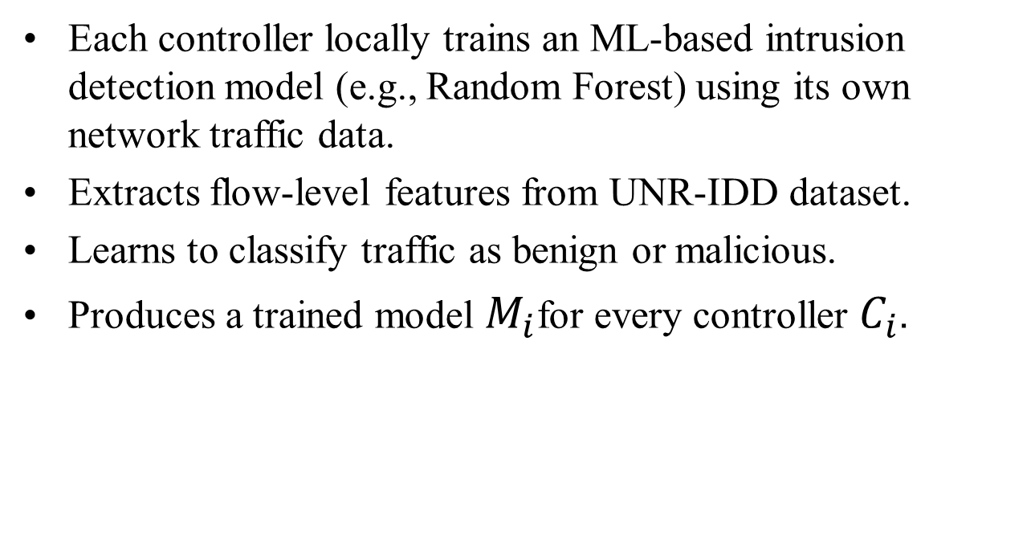
MODEL TRAINING
Each controller locally trains an ML-based intrusion detection model (e.g., Random Forest) using its own network traffic data.
Extracts flow-level features from UNR-IDD dataset.
Learns to classify traffic as benign or malicious.
Produces a trained model $M_{i}$for every controller $C_{i}$.

Slide 13
MODEL TRANSFER
After local training, controllers share their models—not raw data—with peer controllers through the Command Center.
Ensures privacy and bandwidth efficiency.
Each controller receives peer models for cross-evaluation.
Communication occurs via secure REST interfaces.

Slide 14
CROSS EVALUATION
Controllers test each peer’s model using their own validation data.
Computes prediction errors for all received models.
Generates an error matrix representing inter-controller reliability.

Slide 15
WEIGHTED VOTING
Each controller’s vote is assigned a confidence weight proportional to its reliability.
More confident controllers contribute stronger votes.
Reduces the impact of compromised or inaccurate controllers.

Slide 16
FINAL AGGREGATION
The Command Center collects weighted votes from all controllers.
Performs aggregation to derive global detection decisions.
Calculates a suspicion score for each controller.
Controllers exceeding a threshold are flagged as malicious.

Slide 17
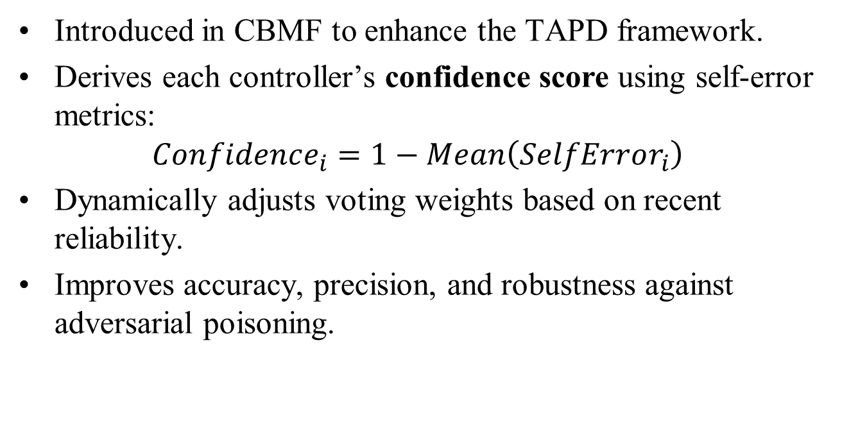
CONFIDENCE SCORING
Introduced in CBMF to enhance the TAPD framework.
Derives each controller’s confidence score using self-error metrics:
$$Confidence_{i}=1−Mean\left(SelfError_{i}\right)$$
Dynamically adjusts voting weights based on recent reliability.
Improves accuracy, precision, and robustness against adversarial poisoning.

Slide 18
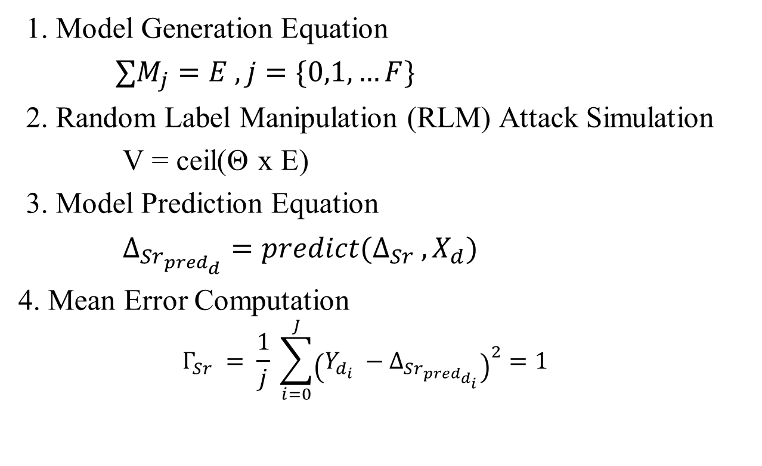
FORMULA USED
1. Model Generation Equation
$∑M_{j}=E , j=\{0,1,…F\}$
2. Random Label Manipulation (RLM) Attack Simulation
V = ceil(Θ x E)
3. Model Prediction Equation
$Δ_{Sr_{pred_{d}}}=predict(Δ_{Sr} , X_{d})$
4. Mean Error Computation
$$Γ_{Sr} = \frac{1}{j} \sum_{i=0}^{J}{{\left(Y_{d_{i}} −Δ_{Sr_{pred_{d_{i}}}}\right)}^{2}}=1$$

Slide 19

FORMULA USED
5.Outlier Detection
$χ_{25}=\left(\frac{1}{4}\right)∗ (N+1)th term$
$χ_{75} =\left(\frac{1}{4}\right)∗ (N+1)th term$
$χ=χ_{75}−χ_{25}$
$ω=χ_{75}+χ ∗η$

Slide 20
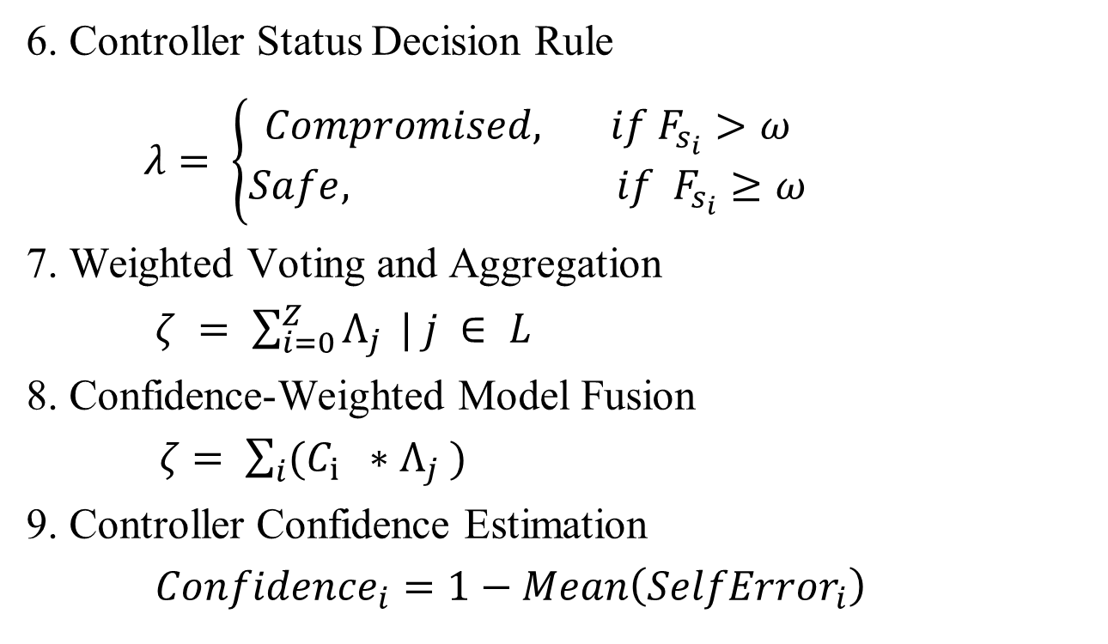
FORMULA USED
6. Controller Status Decision Rule
$λ= \left\{\begin{aligned}Compromised, if F_{s_{i}}>ω \\ Safe, if F_{s_{i}}≥ω\end{aligned}\right.$
7. Weighted Voting and Aggregation
$ζ = \sum_{i=0}^{Z}{Λ_{j}} | j ∈ L$
8. Confidence-Weighted Model Fusion
$ζ= \sum_{i}{(C_{i} ∗Λ_{j} )}$
9. Controller Confidence Estimation
$Confidence_{i}=1−Mean\left(SelfError_{i}\right)$

Slide 21
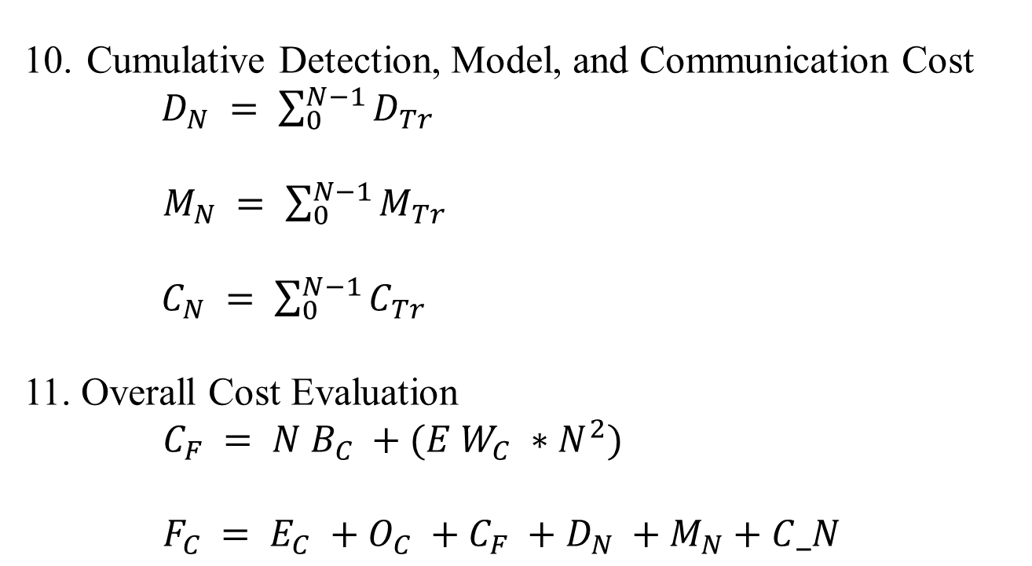
FORMULAS USED
10. Cumulative Detection, Model, and Communication Cost
$D_{N} = \sum_{0}^{N−1}{D_{Tr}}$
$M_{N} = \sum_{0}^{N−1}{M_{Tr}}$
$C_{N} = \sum_{0}^{N−1}{C_{Tr}}$
11. Overall Cost Evaluation
$C_{F} = N B_{C} +(E W_{C} ∗N^{2})$
$F_{C} = E_{C} +O_{C} +C_{F} +D_{N} +M_{N}+C_N$

Slide 22
ALGORITHM
CBMF Algorithm – Controller Side:
Train local ML model using the controller’s own network traffic dataset.
Compute self-error from validation results and derive confidence score.
Receive peer models from other controllers through the Command Center.
Evaluate peer models on local data to calculate cross-evaluation errors.
Detect outliers among peer controllers using the IQR-based method.
Generate weighted votes for suspicious controllers based on confidence.
Send weighted votes and confidence values to the Command Center for aggregation.

Slide 23
ALGORITHM
.
Command Center Side:
Receive weighted votes from all controllers (each includes suspect ID and confidence).
Aggregate votes to compute a global suspicion score for each controller.
Normalize scores for fairness across varying confidence levels.
Apply thresholding (IQR or percentile-based) to isolate suspicious controllers.
Report compromised controllers to the admin or monitoring system.

Slide 24
DATASET
University of Nevada - Reno Intrusion Detection Dataset (UNR-IDD)
Description: The data includes various metrics related to network ports, packets, and bytes, along with timestamps and error counts.
It also contains information about connection points, load rates, and flow entries.
Fields: 35
Size: 38KB
Source: Kaggle
UNR-IDD.xlsx

Slide 25
CONCLUSION
CBMF enhances TAPD by adding trust-based voting.
Provides robust detection of poisoned controllers.
Ensures high accuracy, privacy, and fault tolerance in MSDNs.
Future work: adaptive confidence recalibration and hybrid anomaly models.

Slide 26
EXPERIMENTAL RESULTS
CBMF improves accuracy by 6% and F1 score by 7% over TAPD.
Confidence weighting reduces false positives.
Maintains detection performance even with 3 compromised controllers.
Overhead increase: only ~6.4% runtime cost.

Slide 27
THANK YOU

